Slide 1
HOUSE PRICE PREDICTION
USING
MACHINE LEARNING
Team Members:
Aaditya Upadhyay
Aanchal Tiwari
Akshat Nigam

Slide 2
INTRODUCTION
Machine learning is a branch of Artificial Intelligence which is used to analyse the data more smartly. It automates the process using certain algorithms to minimize human intervention in the process.
In this machine learning project, we are going to predict the house price using python. This project will help the sellers and buyers to have an overview of the situation so that they can act accordingly.

Slide 3
MOTIVATION
In today’s world, everyone wishes for a house that suits their lifestyle and provides amenities according to their needs. House prices keep on changing very frequently which proves that house prices are often exaggerated .
Problems faced during buying a house:
Buying a house is a stressful thing.
Buyers are generally not aware of factors that influence the house prices.
Many problems are faced during buying a house.
Hence real estate agents are trusted with the communication between buyers and sellers as well as laying down a legal contract for the transfer. This just creates a middle man and increases the cost of houses.
They believe that it depends upon: The square foot area,Neighbourhood,No. of bedrooms
But it depends upon many factors also such a s : No. of storeys, Area outside the house, Rooms on one floor.

Slide 4
LIBRARIES AND DEPENDENCIES USED
Linear Regression- Linear regression is a machine learning tool that helps you to make predictions by using the existing data (basically the relationship between the target data and set of other data). In our case, the house price basically depends on the parameters such as the number of bedrooms, location, size of living area, nearby places, etc.) for predicting the price.
pandas- It is an open-source library written for python to perform data analysis and manipulation.
Matplotlib- It is a plotting library for python program and its mathematics extension NumPy.
NumPy- It is a package for python for scientific computing to perform different operations like linear algebra.
sklearn/scikit-learn- It is a free machine learning library developed for python programming language under BSD license which is majorly used for data analysis and data mining. It also supports various machine learning algorithms such as SVM, random forests, k-neighbours, etc.

Slide 5
How this works ?
Exploratory Data Analysis (EDA)
Data Extraction
Dropped columns with more than 20% missing values
imputation with mode
Correlated plot of the values
Distribution of dependent variable
Dataset Preparation (Splitting and Scaling)
Data is divided into the Train set and Test set.
We use the Train set to make the algorithm learn the data’s behavior and then check the accuracy of our model on the Test set.

Slide 6
During Data Pre-Processing
During cleaning and preprocessing,
we created four attributes derived from other attributes
We chose not to use the variable data, because it only shows us when the
data was entered into the database.
We chose not to use latitude and longitude because the attribute, Zipcode, contains the same information and was easier to work with in our models.
We checked for missing variables and the dataset didn’t contain any.
We performed feature selection by looking at the correlation percentage of each attribute with price.

Slide 7
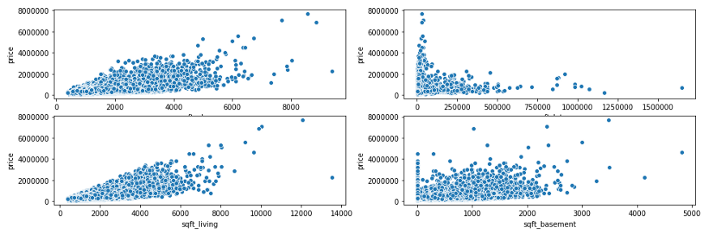
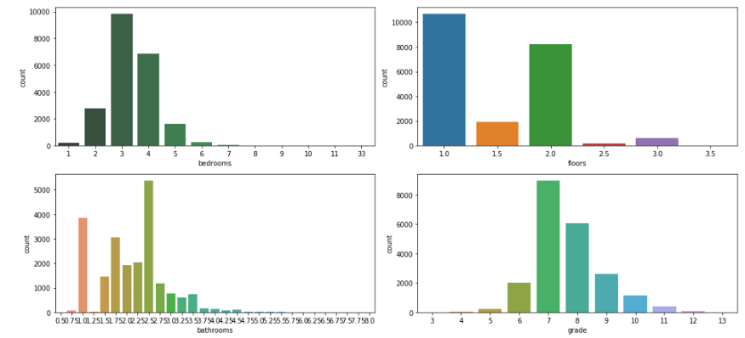
Overview of different features distribution vs house price
Scatterplot — square footage of (home,lot,above and basement)
Countplot- bedrooms, bathrooms, floors, grade

Slide 8
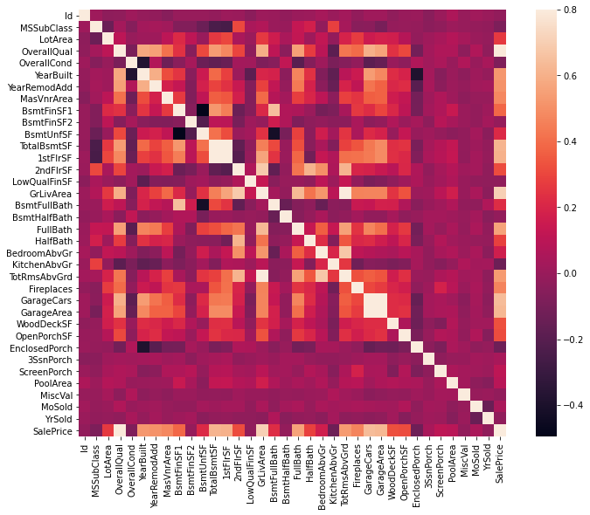
Correlation Matrix
Correlation of 24 Predictor
variables (various factors of a
house ) with Dependent
variable ( House Sale’s Price )
Plotted correlation with
condition (correlation greater
than .325 or less then -.325)
These 24 variables satisfy the
above condition and are
chosen variables

Slide 9
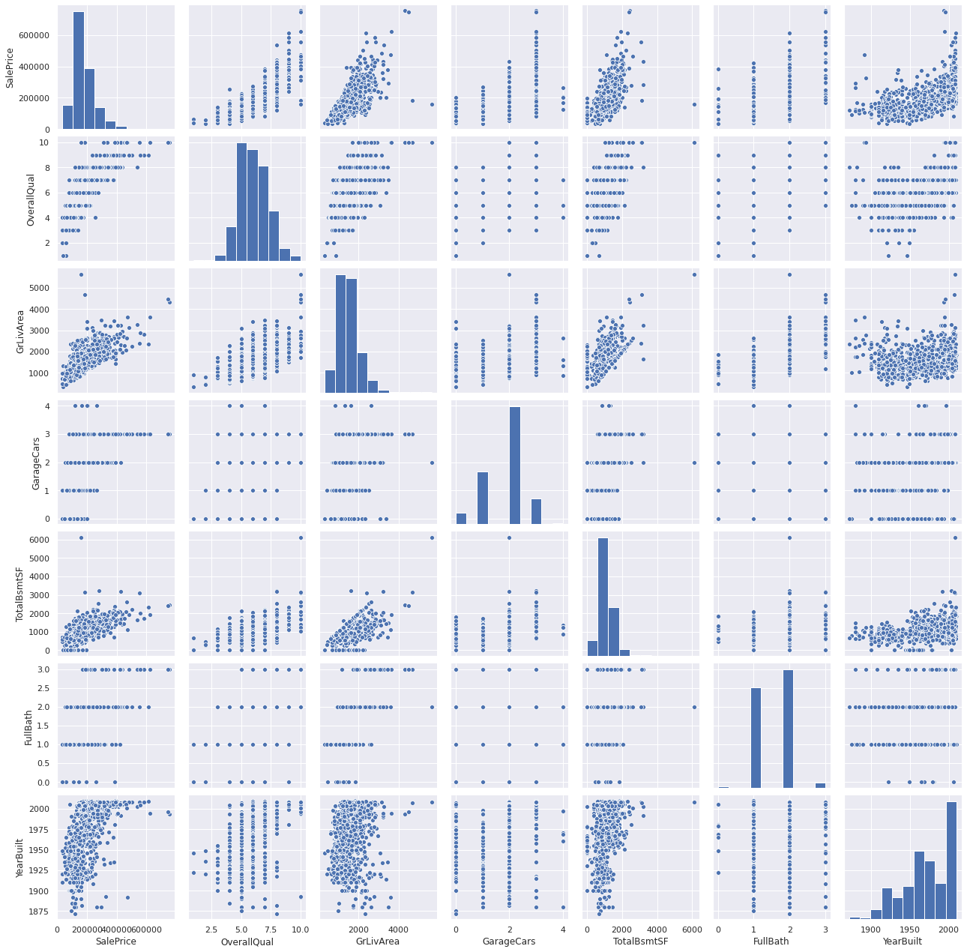
Ploting Scatter plot with some imp columns
cols = ['SalePrice', 'OverallQual', 'GrLivArea', 'GarageCars', 'TotalBsmtSF', 'FullBath', 'YearBuilt']

Slide 10
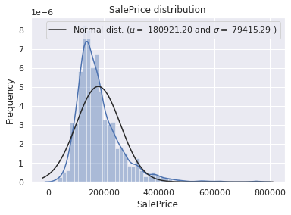
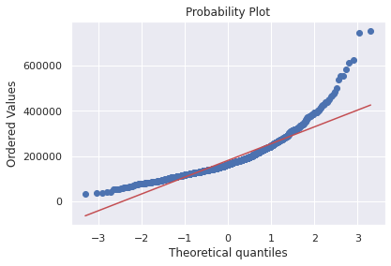
Sales price distribution of the target variable.
We can observe that the target variable Sales Price has a right-skewed distribution, thus we need to “Log Transform” the values because it is normal distribution.
Log transformation of the target variable has helped us fixing its skewed distribution and the new distribution looks closer to normal. Since we have 80 variables, visualizing one by one wouldn't be an astute approach. Instead, we'll look at some variables based on their correlation with the target variable.

Slide 11
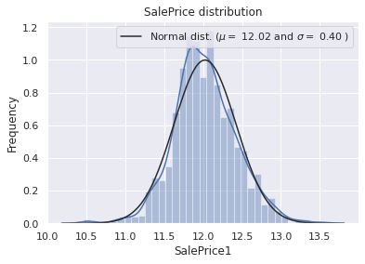
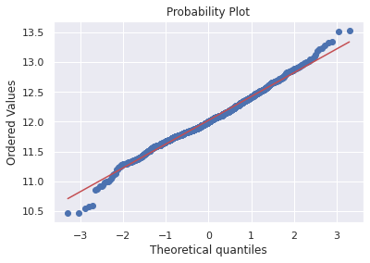
Result of Log Transformation
Removal of skewness

Slide 12
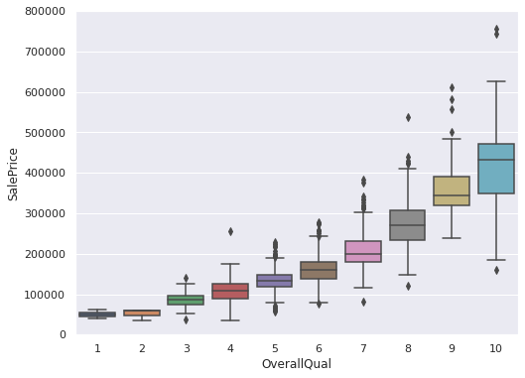
Boxplots for visualizing categorical variables.
OverallQual: Rates the overall material and finish of the house (1 = Very Poor, 10 = Very Excellent)

Slide 13
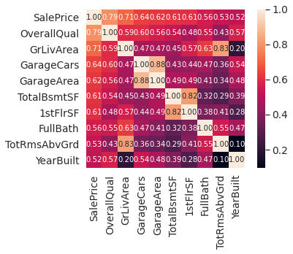
Model Training and Evaluation
After training data using sklearn module our data has been rectified: all the null values as well as outliner values are truncated and data become more readable.

Slide 14
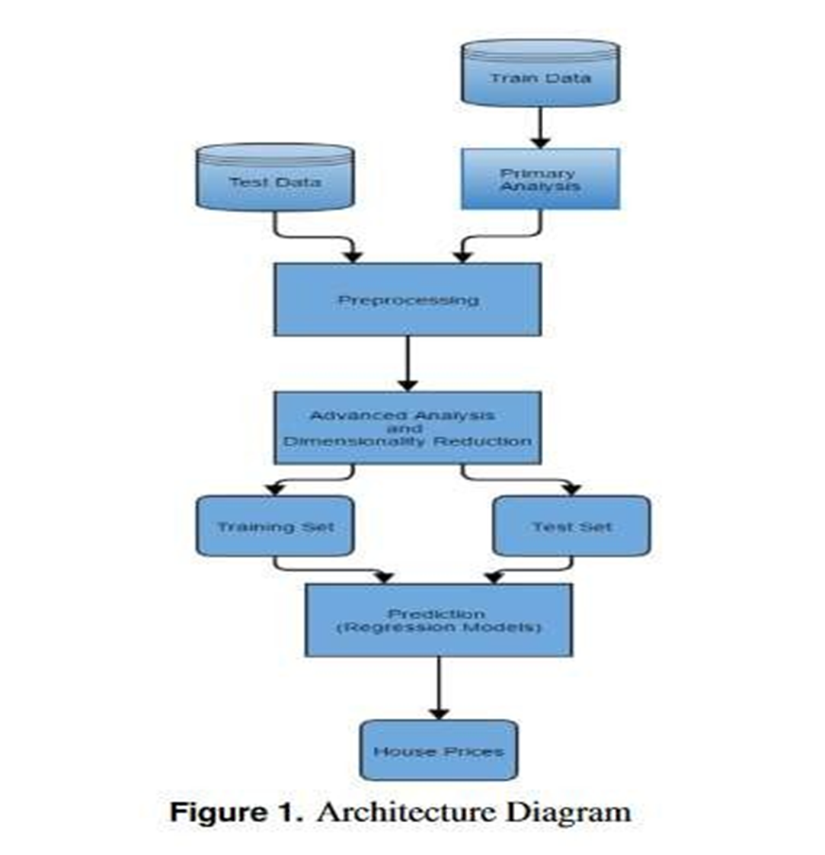

Slide 15
Future Improvements
Our model had a low rmse score, but there is still room for improvement. In a real world scenario, we can use such a model to predict house prices. This model should check for new data, once in a month, and incorporate them to expand the dataset and produce better results.
We can try out other dimensionality reduction techniques like Univariate Feature Selection and Recursive feature elimination in the initial stages.
We can try out other advanced regression techniques, like Random Forest and Bayesian Ridge Algorithm, for prediction. Since the data is highly correlated, we should also try Elastic Net regression technique.

Slide 16
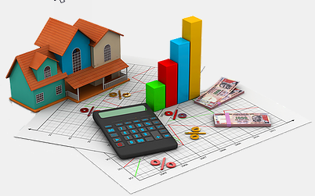
Thank you

